Slide 1

Comp 472 Project 3
Xaavian Ali – 40082861
Julien Picard - 40158060
Donovan Upsdell - 40133717

Slide 2
Word2Vec Google News 300
Biggest Vocabulary size
Very good accuracy
One of the three with 300 embedding size
Statistics | a
Vocabulary Size | 3,000,000
Correctly Labeled | 70
Answers without Guessing | 79
Accuracy | 88.6076%

Slide 3
FastText Wiki News Subwords 300
Vocabulary Nearly 1/3 the size of google news
Best Accuracy of any of the models
One of the three with 300 embedding size
Statistics | a
Vocabulary Size | 999,999
Correctly Labeled | 74
Answers without Guessing | 80
Accuracy | 92.5%

Slide 4
Glove Wiki Gigaword
Smallest Vocabulary Size
Very good accuracy
Nearly identical accuracy with word2vec google news with despite having nearly 10% of the vocabulary size
One of the three with 300 embedding size
Statistics | a
Vocabulary Size | 400,000
Correctly Labeled | 71
Answers without Guessing | 80
Accuracy | 88.75%

Slide 5
Glove Twitter 50
Moderate Vocabulary size
Doesn’t seem to be the deciding factor
Worst Accuracy of every model
Smallest Embedding Size of 50
Statistics | a
Vocabulary Size | 1,193,514
Correctly Labeled | 36
Answers without Guessing | 78
Accuracy | 46.1538%

Slide 6
Glove Twitter 200
Moderate Vocabulary size
Doesn’t seem to be the deciding factor
Slightly better but still low accuracy
Medium Embedding Size of 200
Statistics | a
Vocabulary Size | 1,193,514
Correctly Labeled | 44
Answers without Guessing | 78
Accuracy | 56.4103%

Slide 7
Summary
The models with an embedding size of 300 performed the best
Of those, FastText Wiki News did the best of all, despite having a much smaller vocabulary than Word2Vec
GlovWiki Gigaword similarly demonstrates this effect
Smaller Embedding sizes worked worse, but both models were trained on a twitter dataset which might be worse for this purpose
All 300 embedding size models outperformed the crowdsourced test
Model | Vocab-size | Correct Labels | No Guess
Word2Vec300 | 3000000 | 70 | 79 | 88.61%
FastText300 | 999999 | 74 | 80 | 92.5%
GlovWiki300 | 400000 | 71 | 80 | 88.75%
GloveTwitter50 | 1193514 | 36 | 78 | 46.15%
GloveTwitter200 | 1193514 | 44 | 78 | 56.41%
Random | - | - | - | 25%
Crowdsourced | - | - | - | 85.57%

Slide 8
Summary
All 300 embedding size models outperformed the crowdsourced test and all models outperformed a random baseline
Different Corpus types likely lead to different performance (and are better or worse in different environments. Perhaps the twitter trained models would be better suited to different testing)
Different Types of Embeddings perform differently, or need less training data to be effective (While GloVe worked great with 400000 words, maybe word2Vec would have performed worse with a 400000 word vocabulary)
Model | Vocab-size | Correct Labels | No Guess
Word2Vec300 | 3000000 | 70 | 79 | 88.61%
FastText300 | 999999 | 74 | 80 | 92.5%
GlovWiki300 | 400000 | 71 | 80 | 88.75%
GloveTwitter50 | 1193514 | 36 | 78 | 46.15%
GloveTwitter200 | 1193514 | 44 | 78 | 56.41%
Random | - | - | - | 25%
Crowdsourced | - | - | - | 85.57%

Slide 9
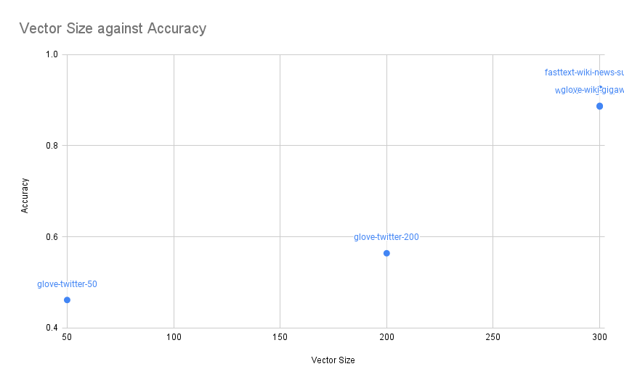
Graph: Vector Size and Accuracy
Best Accuracy Among High Vector Size
Both poorly performing sets are trained on twitter data sets.

Slide 10
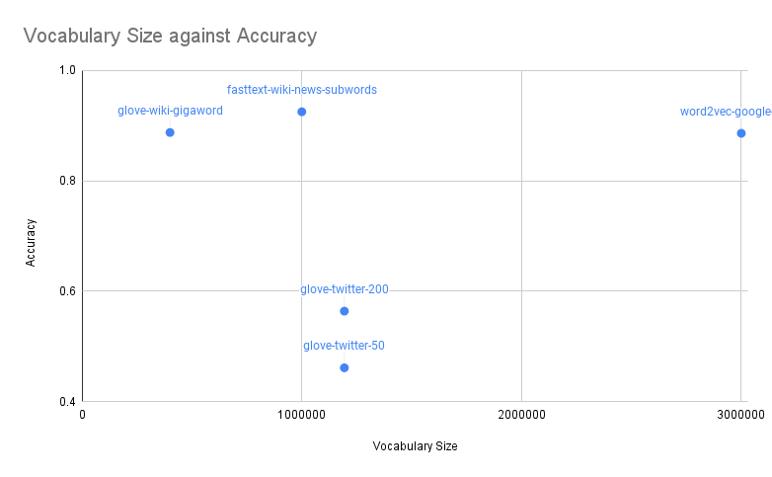
Graph: Vocabulary Size
Vocabulary Size did not seem to have a conclusive effect on the performance of the pre-trained models.

Slide 11
Contributions
Julien Picard – Task 1
Xaavian Ali – Task 2
Donovan Upsdell - Presentation

